Slide 1

Game Maths & Physics
Vectors
Part 3
Dot Product
Cross Product

Slide 2


Slide 3
Most common vector operations in games?
Games tend to use most of the common vector operations
Addition/Subtraction
Scalar multiplication
Normalization
Two others are extremely common:
Dot product
Cross product

Slide 4
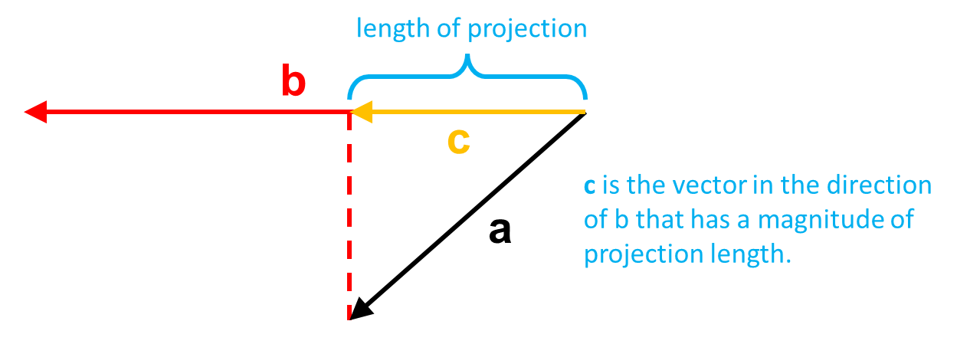
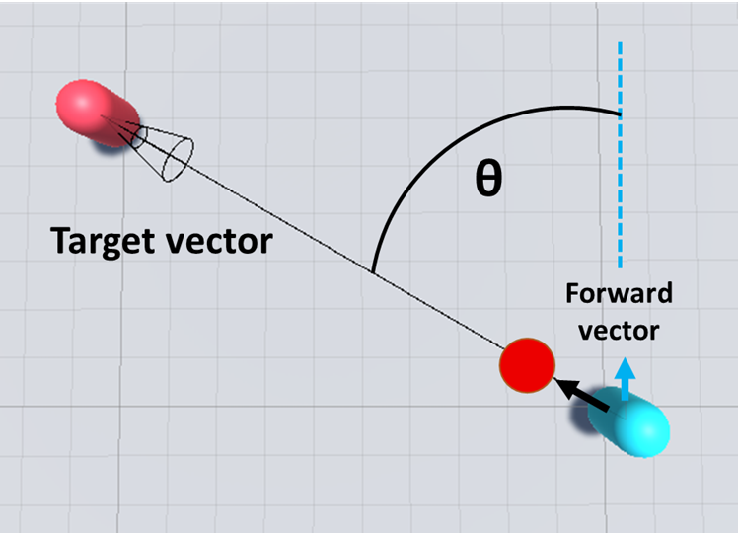
Vector dot product
Find how far vector a projects along vector b
Calculate the angle between 2 vectors

Slide 5
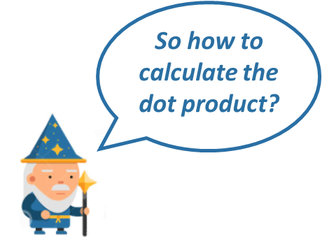
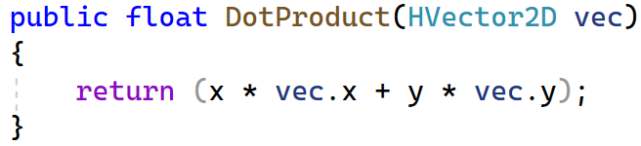
Vector dot product
A
B
x
y
z
*
*
*
x
y
z
A_{x}B_{x} + A_{y}B_{y} + A_{z}B_{z}
x
y
z
x y z
Proper matrix form, which we’ll look at later

Slide 6
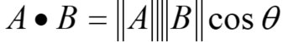
Vector dot product
The dot product can be used to calculate the angle between two vectors
Rearranging, we have:
If A and B are both unit vectors, this simplifies to 1
An example of why vector normalisation is important!
acos

Slide 7
Vector dot product example
Vector A = [1 2 -3] is the direction a spaceship is moving in.
We want the spaceship to turn and follow vector B = [2 3 -2].
What is the angle to turn?
Step 1: First find the dot product of A [1 2 -3] and B [2 3 -2]:
A ∙ B = a₁b₁ + a₂b₂ + a₃b₃
= 1(2) + 2(3) + (-3)(-2)
= 2 + 6 + 6
= 14
Step 2: Next find the magnitude of each vector.

Slide 8
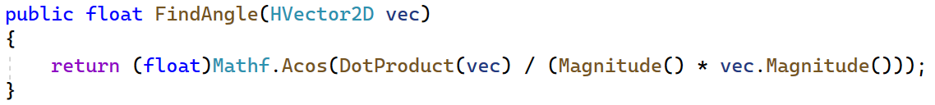
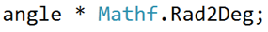
Vector dot product example
Step 3: Plug these 3 values into the formula to calculate
The spaceship has to turn 24.84º to follow the new vector.
The angle returned is in radians
Converts the angle to degrees
angle in degrees

Slide 9
Vector dot product
The dot product can be used to calculate the angle between two vectors
symbol for perpendicular

Slide 10
Vector dot product
Direction vector
Player
B
A.B = 0.7f (spotted!)
A
Forward vector
Guard
Guard field of view
Positive (in front)

Slide 11
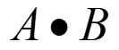
Vector dot product
Player
B
A B = -0.65f (safe)
A
Negative (behind)

Slide 12
Vector dot product
Player
B
= 0
A
Zero (perpendicular)

Slide 13
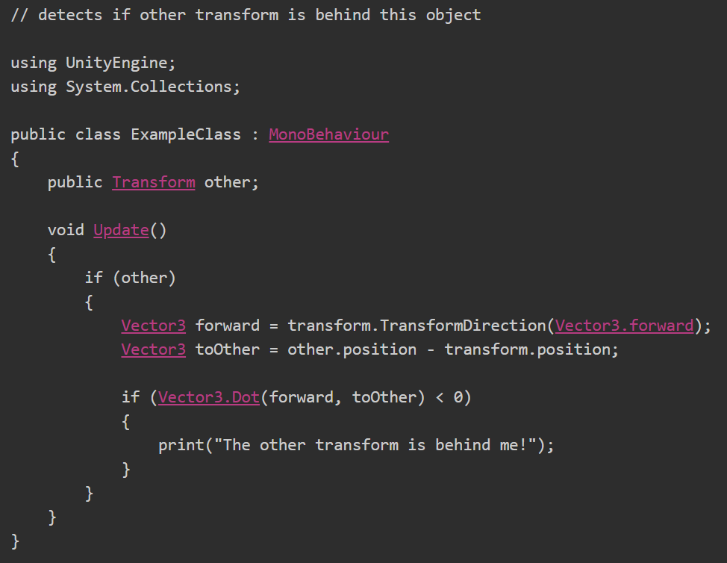
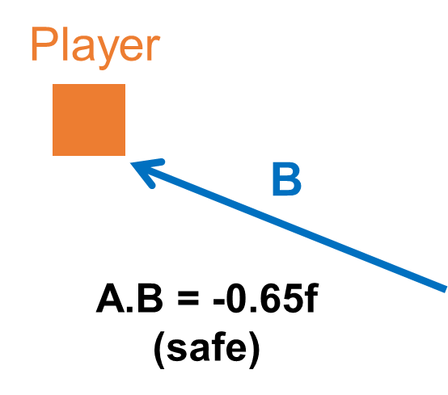
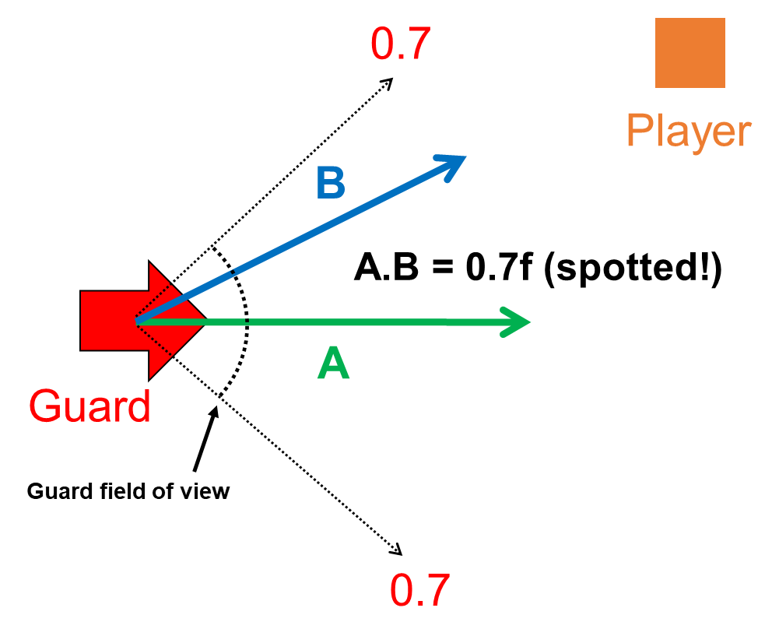
Converts from local to world space, since the object might be parented to another object, e.g. a gun turret
From the Unity docs

Slide 14

To understand deeper, we need to look at the UNIT CIRCLE

Slide 15
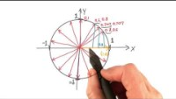
Now we can see how the DOT PRODUCT relates to the UNIT CIRCLE

Slide 16
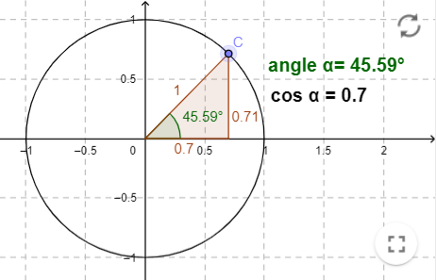
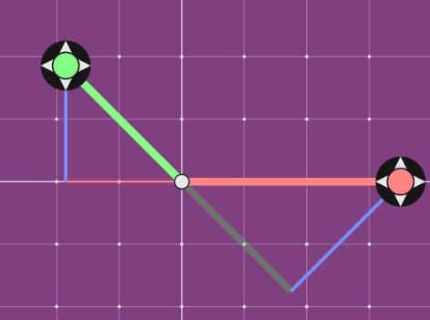
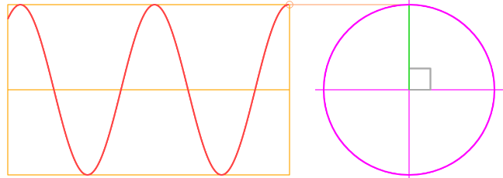
Try these interactive visualisations
https://www.geogebra.org/m/Zyw9wGC2
https://maththebeautiful.com/dot-product/
https://www.mathsisfun.com/algebra/trig-sin-cos-tan-graphs.html

Slide 17
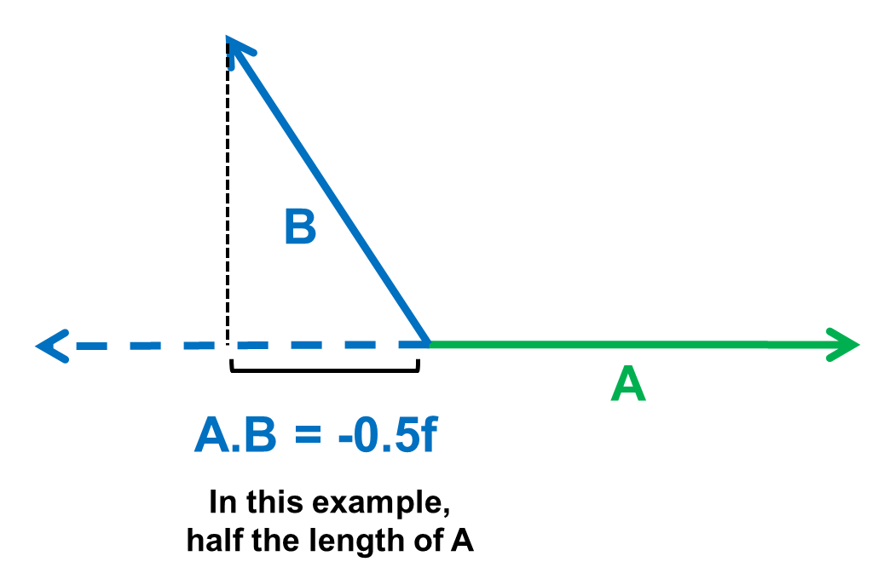
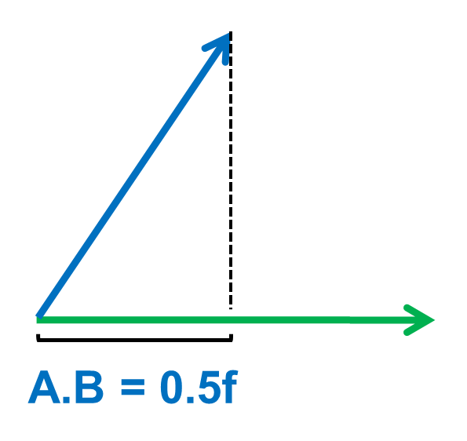
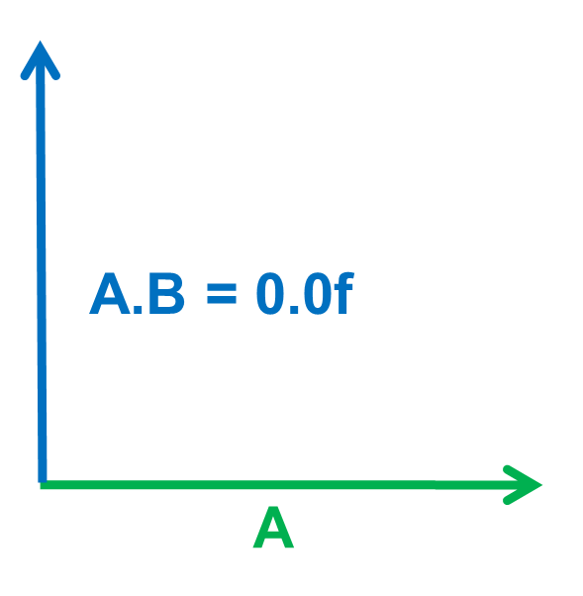
Vector dot product
The dot product is actually the length of the projection of one vector onto another vector
Very important for collision detection
If A.B is 0, then the vectors are perpendicular
In order to get this value range of -1.0 to 1.0, both vectors must be normalized

Slide 18
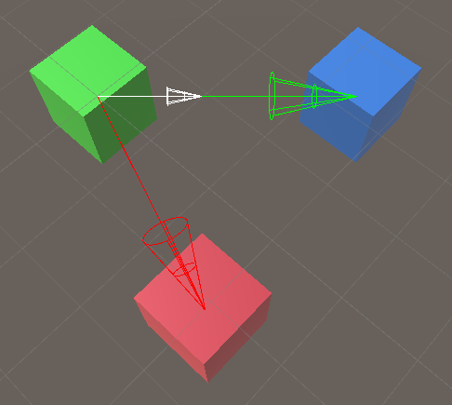
Vector dot product
Length of projection of red onto green

Slide 19
Vector dot product
How can we calculate this?
Vector with length projection in direction of green
green.normalise() * projection

Slide 20
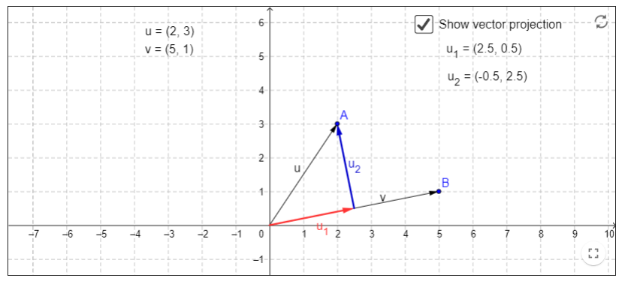
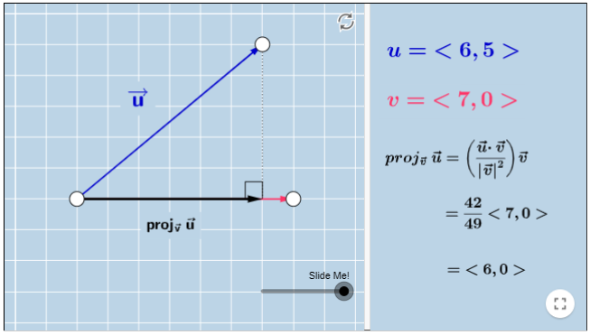
It’s always good to visualise a concept!
https://www.geogebra.org/m/mkV7F8Jf
https://www.geogebra.org/m/wjG2RjjZ

Slide 21
Vector dot product
Projection of a vector a to b is:
This is the same as the square of the length of b, i.e. ||b||²
The result of the projection is a scalar.
This is the projection length of a onto b.
length of projection
b
c
c is the vector in the direction of b that has a magnitude of projection length.
a

Slide 22

Vector dot product
Lets check with some trigonometry
3
0
0
1
0
0
http://www.webconversiononline.com/trigonometry-calculator.aspx
1/3
=
Divide by magnitude to convert to unit vectors
hyp
5
3
4
0
0.6
0.8
0
4
opp
1/5
=
3
0.6
0.8
0
adj
=
0.6 + 0 + 0
= 0.6
1 0 0
cos(θ) = Adjacent / Hypotenus
cos(θ) = 3 / 5
= 0.6 → 53.1º
Value of ACos(0.6) = 53.1º

Slide 23
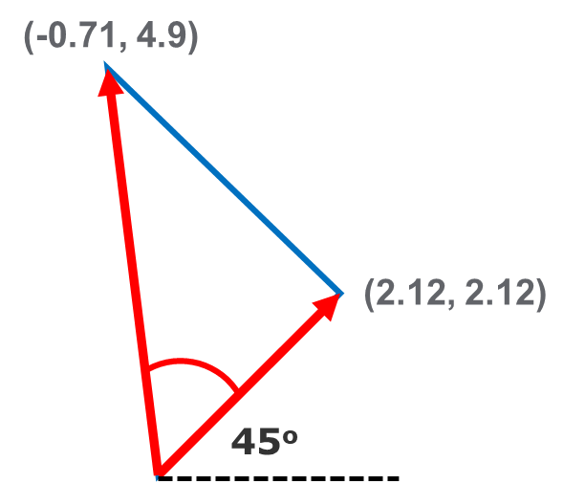
Vector dot product
What if we rotate the vectors?
2.12
2.12
0
.71
.71
0
https://keisan.casio.com/exec/system/1223522781
1/3
=
-.71
4.9
0
.14
.98
0
1/5
=
.14
.98
0
= -0.1 + 0.7 + 0
-.71 .71 0
= 0.6
Value of ACos(0.6) = 53.1º

Slide 24
Vector dot product
Projection can break a vector into component vectors in different directions
Project on x-axis
Project on y-axis

Slide 25
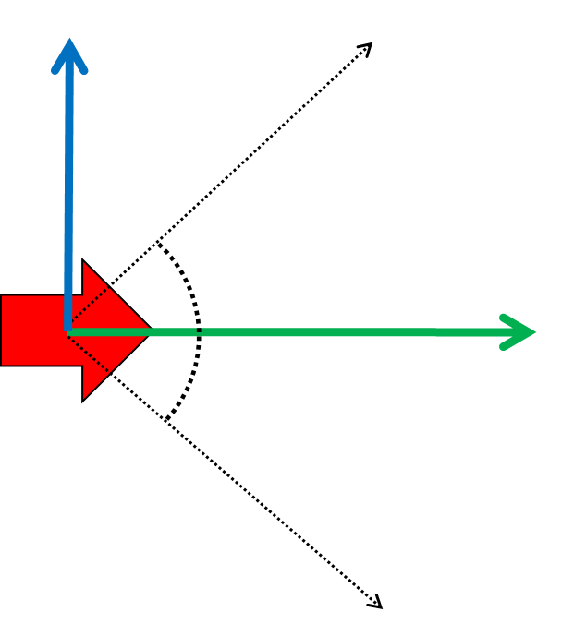
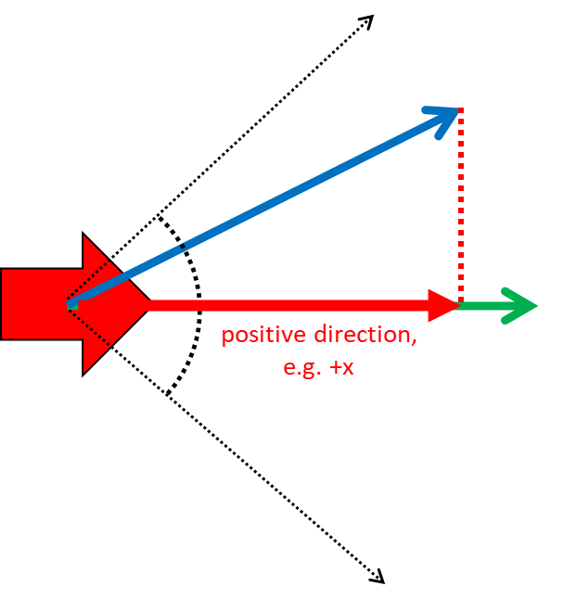
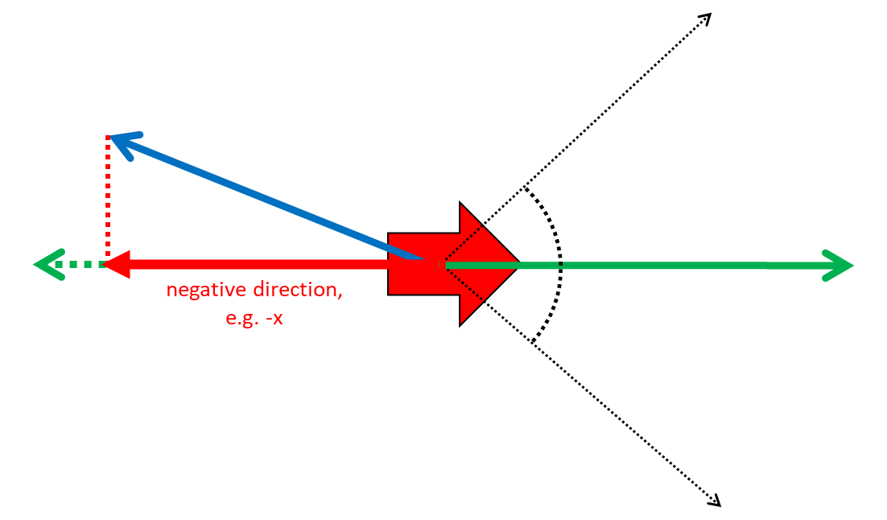
Vector dot product
This projection explains why the dot product can be used to check visibility
Positive – in front
Negative – behind
Zero – perpendicular

Slide 26
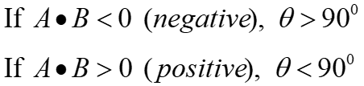
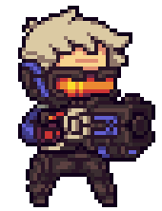

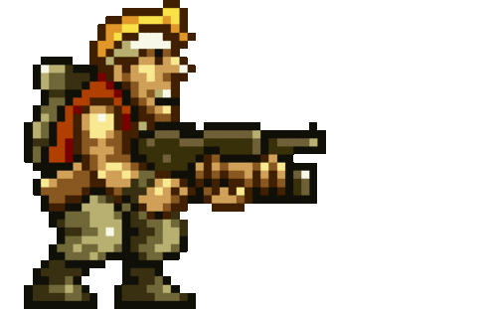
Vector dot product
0 dot product
At right angles
-
+
-ve dot product
+ve dot product
Behind!
In front!
A more intuitive understanding!

Slide 27
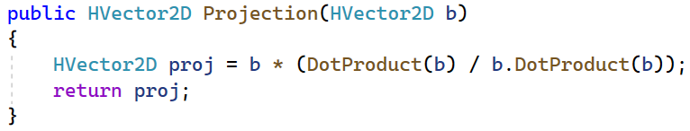
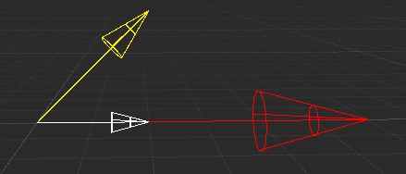
Vector dot product
Dot product of b with itself is the same as b*b
Projection of a onto b
a is this vector

Slide 28
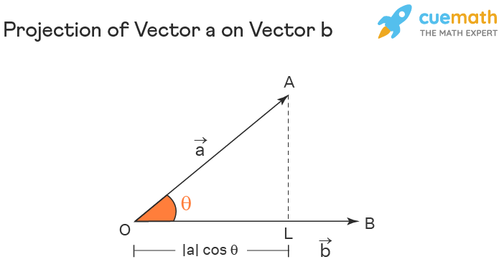
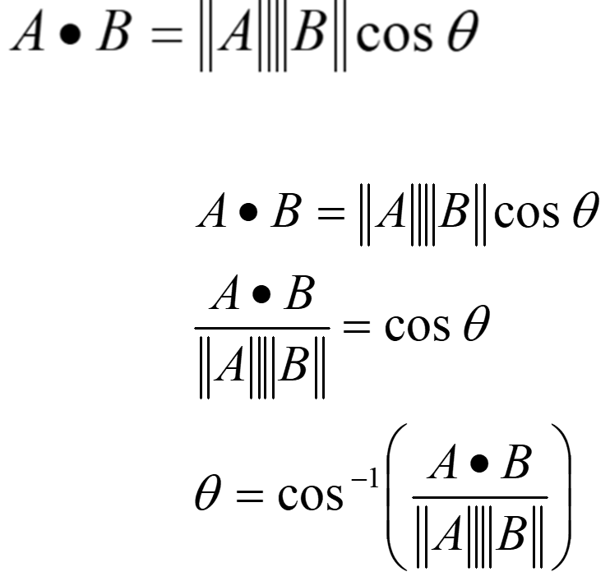
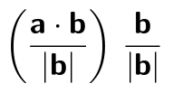
Extra slide
^
b

Slide 29
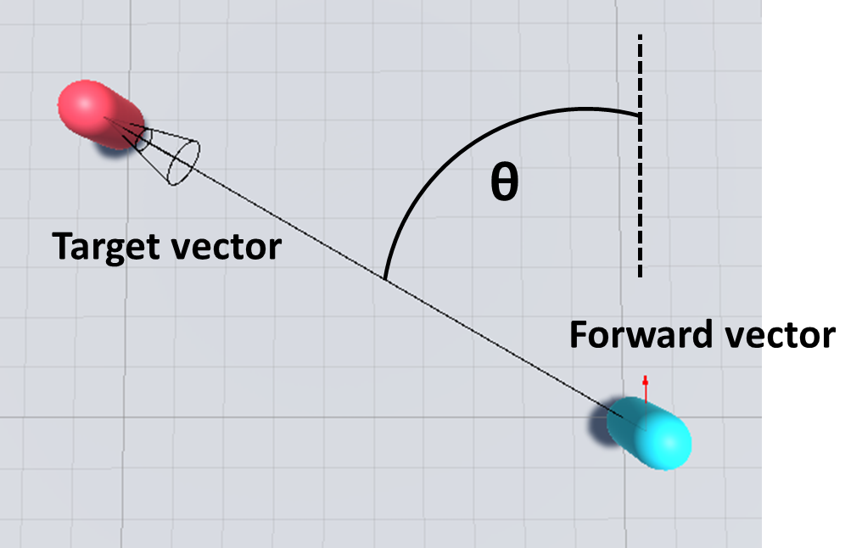
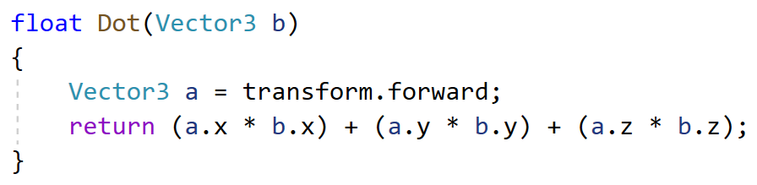
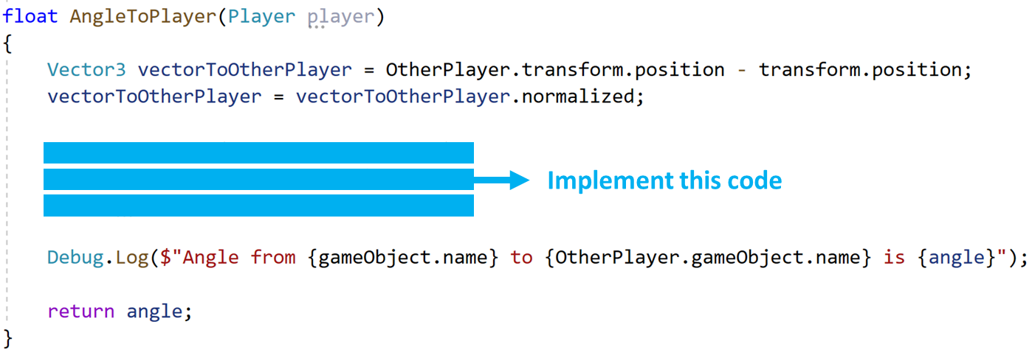
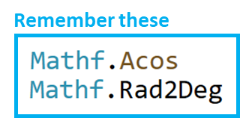
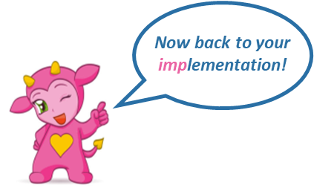
Vector dot product
Soccer problem …
Both vectors must be normalised

Slide 30
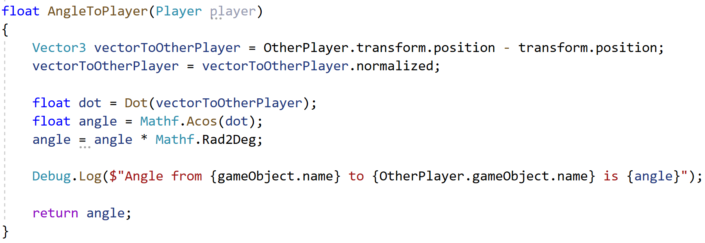
Vector dot product
Solution

Slide 31
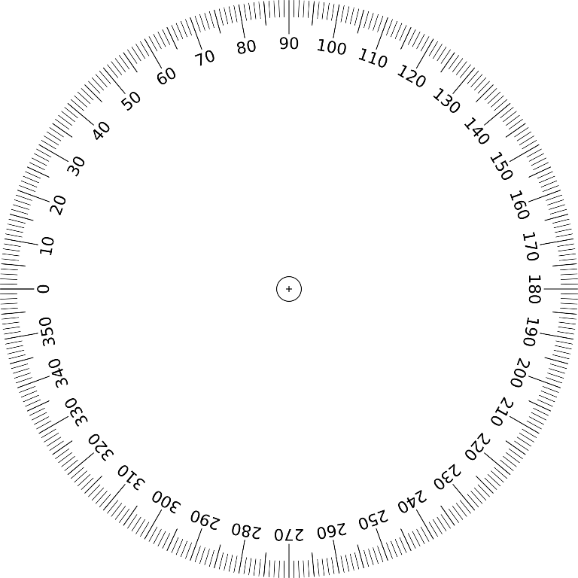
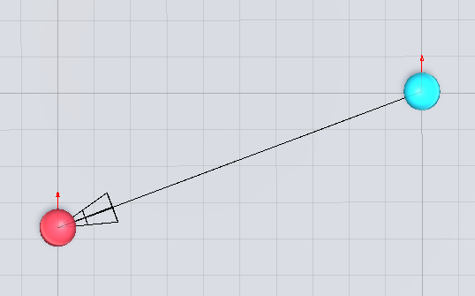
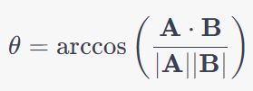
Vector dot product
Angle from Captain to Player 1 is 110.5º
What is θ from Captain to Player 1?
Let’s test it out!
Vector A = (0, 1)
(0.0)
Captain
Vector B = (-10, -3.75)
θ from Vector A to Vector B:
Player 1
(-10.0, -3.75)
= −3.75 / (1.0 * 10.68)
= -0.35
arccos(-0.35) = 1.93 radians
= 110.5 degrees

Slide 32
Vector dot product
What is θ from Player 1 to Captain?
Angle from Player 1 to Captain is 69.5º
(0.0)
Captain
θ from Vector A to Vector B:
Vector A = (0, 1)
Vector B = (10, 3.75)
from Player 1 to Captain
Player 1
(-10.0, -3.75)
= 69.5 degrees

Slide 33
Vector dot product
Angle from Captain to Player 1 is 110.5º
Angle from Player 1 to Captain is 69.5º
(0.0)
Captain
110.5 + 69.5 = 180.0
Player 1
(-10.0, -3.75)

Slide 34
Vector cross product
The vector cross product calculates another vector that is perpendicular to 2 vectors
C = A x B
C
B
A
This is incredibly important, especially in computer graphics and physics!

Slide 35
Vector cross product
The cross product is one of the 2 ways to “multiply” vectors. (Dot product is the other way)
Cross product returns another vector that is perpendicular to both the original vectors.
Cross product is sometimes called the vector product.
Symbol: x
e.g. A x B
Why?
Because it returns a vector!

Slide 36
Vector cross product
Formula: Geometric definition
a x b
=
a
b
sin θ
magnitude of a multipled by magnitude of b
sine of the angle between a and b
magnitude of a cross b
=
*
A scalar value
Remember the dot product
A scalar value

Slide 37
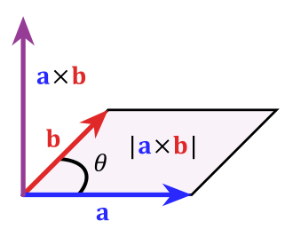
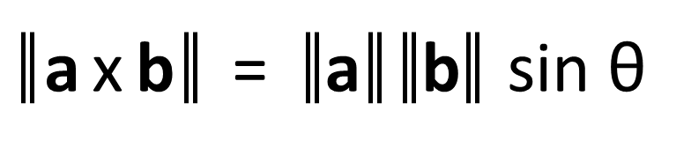
Vector cross product
The vector cross product is also equal to the area of the parallelogram between a and b
Let’s look at this for orthogonal vectors
which form a rectangle (a special case of a parallelogram)
a x b
=
a
b
sin θ
b
b
90º
90º
a
a
The area of the rectangle formed by a and b is length a * length b
sin 90º = 1

Slide 38
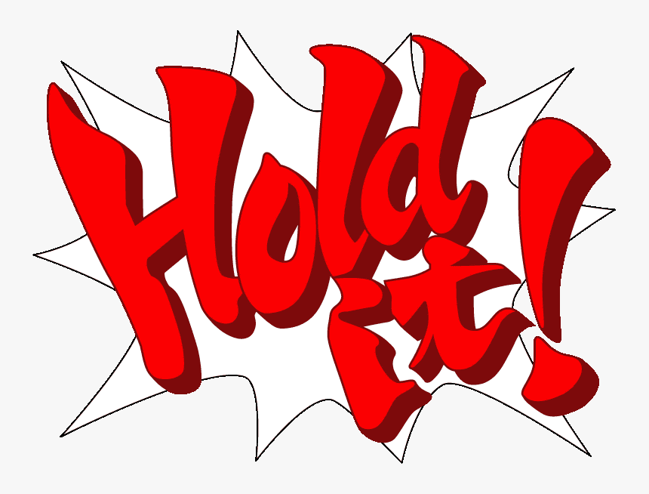

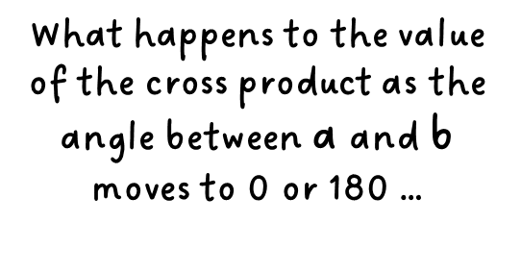

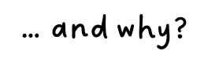
b
a
b
a
b
a
https://www.ace-attorney.com/great1-2/us/character/

Slide 39
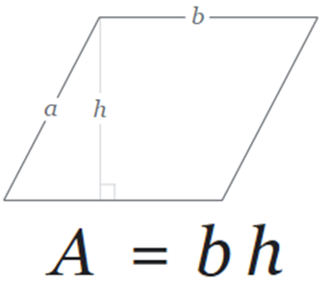
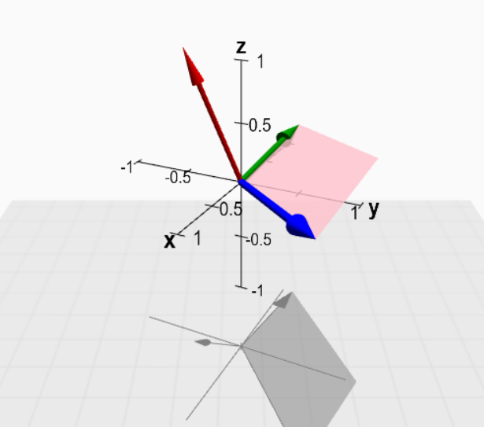
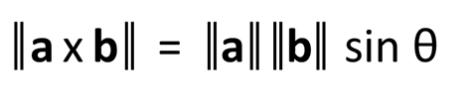
Vector cross product
The value is 0 for parallel vectors
https://mathinsight.org/cross_product
Interactive demo
At 0º or 180º the height of the parallelogram is 0
Also, sin 0 and sin 180 are 0

Slide 40
Vector cross product
Formula:
The cross product can be described by Sarrus' scheme:
-
-
-
i j k i j k
a₁ a₂ a₃ a₁ a₂ a₃
b₁ b₂ b₃ b₁ b₂ b₃
+
+
+
i(a₂b₃)+ j(a₃b₁) + k(a₁b₂) – i(a₃b₂) – j(a₁b₃) – k(a₂b₁)

Slide 41

Vector cross product
Given, A = [3 4 8] and B=[-4 1 5]. Find A x B.
(4(5) – 8(1))
(8(-4) – 3(5))
(3(1) – 4(-4))
(20 – 8)
(-32 – 15)
(3 + 16)
12 -47 19

Slide 42



Vector cross product
Uses of the cross product
Find the local Up vector from any forward vector using the Double Cross Product.
a x (b x c)
First calculate the cross product of the Forward vector with the world Up vector to find the Right vector.
Then calculate the cross product of the Forward and Right vector to find the local Up vector.

Slide 43

Vector cross product
Uses of the cross product
Calculate the angle at which a ball bounces.

Slide 44



Vector cross product
Uses of the cross product
Used in Gouraud Shading to calculate the angle at which light approaches the camera.

Slide 45

Vector cross product
Uses of the cross product
Finding surface normals
Recall that everything in a 3D world is made up of triangles.
Every triangle has 3 vertices.
Using the 3 vertices we can get 2 vectors.
Using the 2 vectors we can get the normal of that triangle/ surface using the cross product:
The surface normal is a unit vector, i.e. length = 1

Slide 46
Vector cross product
Example of finding a surface normal
A surface is defined by 2 vectors, A = [3 4 8] and B=[-4 1 5].
Find the surface normal so that it can be used to determine the surface normal after a collision.
Solution:
Step 1. Cross product returns another vector:
= [(4(5) – 8(1)) (8(-4) – 3(5)) (3(1) – 4(-4))]
= [(20 - 8) (-32 – 15) (3 + 16) ]
= [ 12 47 19 ]

Slide 47
Step 2. Find the magnitude of AxB:
Step 3. Surface normal = normalized AxB

Slide 48

Vector cross product
https://web.iit.edu/sites/web/files/departments/academic-affairs/academic-resource-center/pdfs/Cross_Product_Workshop.pdf

Slide 49


Vectors A, B and C
magnitude is 0, so must be the zero vector
= 0
sin θ = 0
A ∙ B = 0
θ = 0º
A
C
→ Cos θ = 0
The angle between A and C is 0.
→ θ = 90º
A and C are parallel.
B
https://www.quora.com/If-there-are-three-vectors-the-dot-product-between-the-first-and-second-vector-is-zero-and-the-cross-product-between-first-and-third-vector-zero-What-is-the-angle-between-the-second-vector-and-the-third-vector

Slide 50

Vector cross product
The order of the 2 vectors is important!
Crossing the wrong way gives a negative (opposite) vector!
a x b != b x a

Slide 51


Vector cross product
The right-hand rule is used to determine the direction of the cross product vector.
Used in “real” physics, where by convention the coordinate system of the world is agreed to be right-handed.
c
a
b

Slide 52


Vector cross product
Coordinate systems in 3D graphics are virtual, so can be left or right-handed
But for 3D programming, it can get tricky!
Unity is left-handed, so the cross product follows the left-hand rule.
The left hand rule applied to Cross(a, b)
https://docs.unity3d.com/ScriptReference/Vector3.Cross.html
Unity documentation

Slide 53


https://anime-pictures.net/pictures/view_post/735474
Listening in class
Now finish Questions 6 & 7!

Slide 54

QUESTION 6 - Review
Magnitude of vector = velocity
5. Set velocity
1. Click on white ball
2. Drag mouse
3. Draw line
4. Release mouse
Problems:
How to check if the mouse position is inside the ball?
How to draw the line to represent the velocity vector?
How to set the velocity of the ball?
How to move the ball according to its velocity?

Slide 55

How to check if the mouse position is inside the ball?
Distance from ball position to mouse position
Position
Radius
(x,y)
(x,y)
(x,y)
If the distance from the ball position to the mouse position is less than the ball radius, then the mouse is inside the ball.

Slide 56




